Slide 1
Parsing and Membership
The term parsing describes finding a sequence of productions by which a w ∈ L(G) is derived.
An algorithm that can tell us whether w is in L(G) is a membership algorithm
We systematically construct all possible (say, leftmost) derivations and see whether any of them match w.
We use exhaustive search parsing or brute force parsing. It is a form of top-down parsing, which we can view as the construction of a derivation tree from the root down.

Slide 2
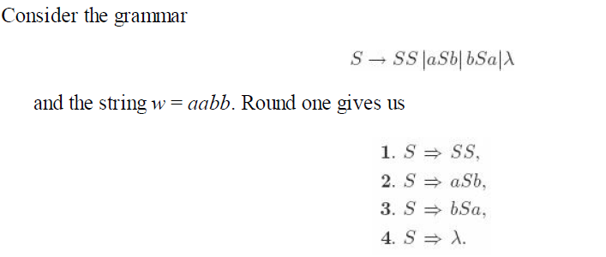
Here we remove 3 and 4 because string w cannot be derived from that productions.

Slide 3
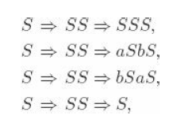
Round 2:

Slide 4
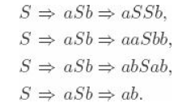

Round 3
Round 4

Slide 5
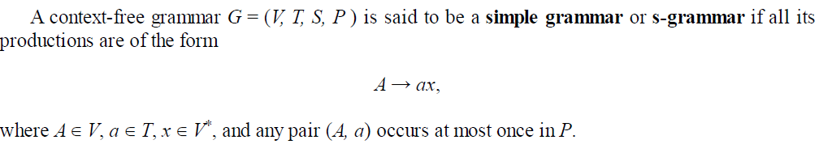
Simple Grammar or S - Grammar

Slide 6
